Slide 1




INTRODUCTION
INTRODUCTION
Research paper presentation
INTRODUCTION
INTRODUCTION
INTRODUCTION
INTRODUCTION
INTRODUCTION
INTRODUCTION
INTRODUCTION
Behavioral
Trees
INTRODUCTION
INTRODUCTION

Slide 2
INTRODUCTION
INTRODUCTION
INTRODUCTION
INTRODUCTION
INTRODUCTION
INTRODUCTION
INTRODUCTION
INTRODUCTION
INTRODUCTION
INTRODUCTION
INTRODUCTION

Slide 3

Basic Concepts
1
3
Control node
Condition node
2
4
Decorator node
Action node

Slide 4


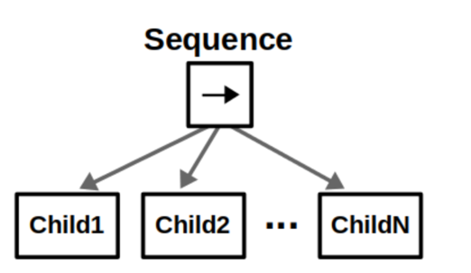
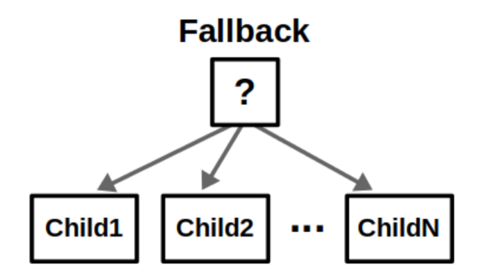
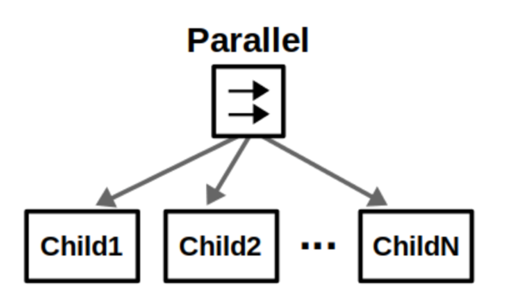
Control Nodes
Fallback
Parallel
Sequence

Slide 5
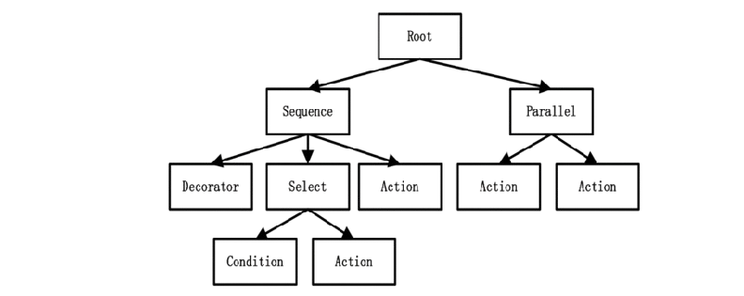
Finite state machines
vs.
Behavior Trees

Slide 10

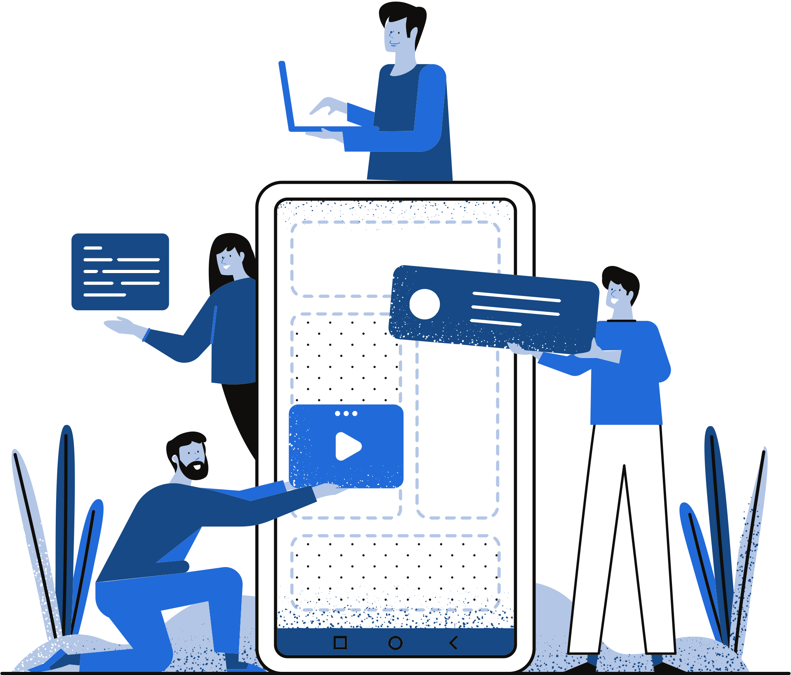
THANK YOU!

